Slide 1
CH05 Database and Cloud Security
ZJU 2020
Notes:
This chapter provides an overview of computer security. We begin with a discussion
of what we mean by computer security. In essence, computer security deals
with computer-related assets that are subject to a variety of threats and for which
various measures are taken to protect those assets. Accordingly, the next section of
this chapter provides a brief overview of the categories of computer-related assets
that users and system managers wish to preserve and protect, and a look at the
various threats and attacks that can be made on those assets. Then, we survey the
measures that can be taken to deal with such threats and attacks. This we do from
three different viewpoints, in Sections 1.3 through 1.5. We then lay out in general
terms a computer security strategy.
The focus of this chapter, and indeed this book, is on three fundamental
questions:
1. What assets do we need to protect?
2. How are those assets threatened?
3. What can we do to counter those threats?

Slide 2
Databases
Structured collection of data stored for use by one or more applications
Contains the relationships between data items and groups of data items
Can contain sensitive data that needs to be secured
Database management system (DBMS)
Suite of programs for constructing and maintaining the database
SQL (Structured Query language) provides a uniform interface to the database
Notes:
Organizational databases tend to concentrate sensitive information in a single
logical system. Examples include:
• Corporate financial data
• Confidential phone records
• Customer and employee information, such as name, Social Security number,
bank account information, credit card information
• Proprietary product information
• Health care information and medical records
For many businesses and other organizations, it is important to be able to
provide customers, partners, and employees with access to this information. But such
information can be targeted by internal and external threats of misuse or unauthorized
change. Accordingly, security specifically tailored to databases is an increasingly
important component of an overall organizational security strategy.
In some cases, an organization can function with a relatively simple collection of files of
data. Each file may contain text (e.g., copies of memos and reports) or numerical data
(e.g., spreadsheets). A more elaborate file consists of a set of records. However, for an
organization of any appreciable size, a more complex structure known as a database
is required. A database is a structured collection of data stored for use by one or more
applications. In addition to data, a database contains the relationships between data
items and groups of data items. As an example of the distinction between data files
and a database, consider the following. A simple personnel file might consist of a set
of records, one for each employee. Each record gives the employee’s name, address,
date of birth, position, salary, and other details needed by the personnel department.
A personnel database includes a personnel file, as just described. It may also
include a time and attendance file, showing for each week the hours worked by each
employee. With a database organization, these two files are tied together so that a
payroll program can extract the information about time worked and salary for each
employee to generate paychecks.
Accompanying the database is a database management system (DBMS) ,
which is a suite of programs for constructing and maintaining the database and for
offering ad hoc query facilities to multiple users and applications. A query language
provides a uniform interface to the database for users and applications.

Slide 3
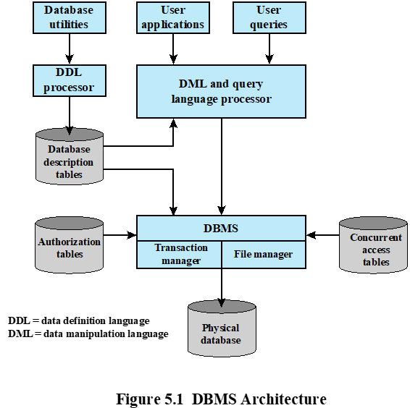

Slide 4
OS vs. DB Security
OS security mechanisms typically control read and write access to entire files, but they could not be used to limit access to specific records or fields in that file.
A DBMS typically allows this type Fine-grained access control to be specified. It also enables access controls to be specified over a range of SQL commands, such as to select, insert, update, or delete specified items in the database.
Thus, security services and mechanisms are needed that are designed specifically fordatabase systems.

Slide 5
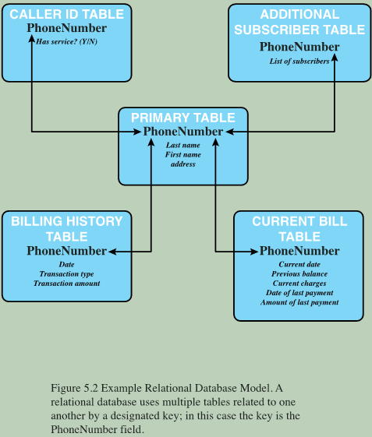
Relational Databases
A relational database consists of relations or tables
A table is defined by a schema and consists of tuples
Each tuple (row) stores attribute values as define by schema
Typically, one column contains the primary key, each uniquely identifies a tuple
Enables the creation of multiple tables linked together by keys
Notes:
The basic building block of a relational database is a table of data, consisting of rows
and columns, similar to a spreadsheet. Each column holds a particular type of data,
while each row contains a specific value for each column. Ideally, the table has at
least one column in which each value is unique, thus serving as an identifier for a
given entry. For example, a typical telephone directory contains one entry for each
subscriber, with columns for name, telephone number, and address. Such a table is
called a flat file because it is a single two-dimensional (rows and columns) file. In a
flat file, all of the data are stored in a single table. For the telephone directory, there
might be a number of subscribers with the same name, but the telephone numbers
should be unique, so that the telephone number serves as a unique identifier for a
row. However, two or more people sharing the same phone number might each be
listed in the directory. To continue to hold all of the data for the telephone directory
in a single table and to provide for a unique identifier for each row, we could require
a separate column for secondary subscriber, tertiary subscriber, and so on. The result
would be that for each telephone number in use, there is a single entry in the table.
The drawback of using a single table is that some of the column positions for
a given row may be blank (not used). Also, any time a new service or new type of
information is incorporated in the database, more columns must be added and the
database and accompanying software must be redesigned and rebuilt.
The relational database structure enables the creation of multiple tables
tied together by a unique identifier that is present in all tables.
Users and applications use a relational query language to access the database.
The query language uses declarative statements rather than the procedural
instructions of a programming language. In essence, the query language allows
the user to request selected items of data from all records that fit a given set of
criteria. The software then figures out how to extract the requested data from one
or more tables. For example, a telephone company representative could retrieve a
subscriber’s billing information as well as the status of special services or the latest
payment received, all displayed on one screen.

Slide 6

Relational Database Elements
Primary key
Uniquely identifies a row
Consists of one or more column names
Foreign key
Links one table to attributes in another
View/virtual table
Result of a query that returns selected rows and columns from one or more tables
Notes:
In relational database parlance, the basic building block is a relation , which is a
flat table. Rows are referred to as tuples , and columns are referred to as attributes
A primary key is defined to be a portion of a row used to uniquely
identify a row in a table; the primary key consists of one or more column names.
In the example of Figure 5.2 , a single attribute, PhoneNumber, is sufficient to
uniquely identify a row in a particular table.
To create a relationship between two tables, the attributes that define the
primary key in one table must appear as attributes in another table, where they are
referred to as a foreign key . Whereas the value of a primary key must be unique
for each tuple (row) of its table, a foreign key value can appear multiple times in
a table, so that there is a one-to-many relationship between a row in the table with
the primary key and rows in the table with the foreign key.
A view is a virtual table. In essence, a view is the result of a query that returns
selected rows and columns from one or more tables.
Views are often used for security purposes. A view can provide restricted access to a
relational database so that a user or application only has access to certain rows or columns.

Slide 8
Notes:
Figure 5.4a provides an
example. In the Department table, the department ID (Did ) is the primary key;
each value is unique. This table gives the ID, name, and account number for each
department. The Employee table contains the name, salary code, employee ID, and
phone number of each employee. The Employee table also indicates the department
to which each employee is assigned by including Did . Did is identified as a foreign key
and provides the relationship between the Employee table and the Department table.
Figure 5.4b is a view that
includes the employee name, ID, and phone number from the Employee table and
the corresponding department name from the Department table. The linkage is the
Did , so that the view table includes data from each row of the Employee table, with
additional data from the Department table. It is also possible to construct a view
from a single table. For example, one view of the Employee table consists of all
rows, with the salary code column deleted. A view can be qualified to include only
some rows and/or some columns. For example, a view can be defined consisting of
all rows in the Employee table for which the Did = 15.

Slide 9
Structured Query Language (SQL)
Standardized language to define schema, manipulate, and query data in a relational database.
Operations include:
Create tables
Insert and delete data in tables
Create views
Retrieve data with query statements
Example: SELECT * FROM EMLPOYEE WHERE DID=‘15’
return all tuples in EMPLOYEE table with attribute DID=‘15’
Notes:
Structured Query Language (SQL) is a standardized language that can be used to
define schema, manipulate, and query data in a relational database. There are several
versions of the ANSI/ISO standard and a variety of different implementations,
but all follow the same basic syntax and semantics.
SQL statements
can be used to create tables, insert and delete data in tables, create views, and
retrieve data with query statements.
create, select, insert, update, join, delete…

Slide 10
SQL Injection Attacks (SQLi)
Most common attack goal is bulk extraction of data
Can also
Modify or delete data
Execute arbitrary operating system commands
Notes:
The SQL injection (SQLi) attack is one of the most prevalent and dangerous
network-based security threats. Consider the following reports:
1. The July 2013 Imperva Web Application Attack Report [IMPE13] surveyed a
cross-section of Web application servers in industry and monitored eight different
types of common attacks. The report found that SQLi attacks ranked
first or second in total number of attack incidents, the number of attack
requests per attack incident, and average number of days per month that an
application experienced at least one attack incident. Imperva observed a single
Web site that received 94,057 SQL injection attack requests in one day.
2. The Open Web Application Security Project’s 2013 report [OWAS13] on the
ten most critical Web application security risks listed injection attacks, especially
SQLi attacks, as the top risk. This ranking is unchanged from its 2010 report.
3. The Veracode 2013 State of Software Security Report [VERA13] found that
percentage of applications affected by SQLi attacks is around 32% and that
SQLi attacks account for 26% of all reported breaches. Veracode also considers
this among the most dangerous threats, reporting that three of the biggest
SQL injection attacks in 2012 resulted in millions of email addresses, user
names, and passwords being exposed and damaged the respective brands.
4. The Trustwave 2013 Global Security Report [TRUS13] lists SQLi attacks as
one of the top two intrusion techniques. The report notes that poor coding
practices have allowed the SQL injection attack vector to remain on the threat
landscape for more than 15 years, but that proper programming and security
measures can prevent these attacks.
In general terms, an SQLi attack is designed to exploit the nature of Web application
pages. In contrast to the static Web pages of years gone by, most current Web sites
have dynamic components and content. Many such pages ask for information, such
as location, personal identity information, and credit card information. This dynamic
content is usually transferred to and from back-end databases that contain volumes of
information—anything from cardholder data to which type of running shoes is most
purchased. An application server Web page will make SQL queries to databases to
send and receive information critical to making a positive user experience.
In such an environment, an SQLi attack is designed to send malicious SQL
commands to the database server. The most common attack goal is bulk extraction
of data. Attackers can dump database tables with hundreds of thousands of customer
records. Depending on the environment, SQL injection can also be exploited
to modify or delete data, execute arbitrary operating system commands, or launch
denial-of-service (DoS) attacks.

Slide 11
SQL Injection Attacks (SQLi)
Sends malicious SQL commands to the database
One of the most prevalent and dangerous network-based security threats
Designed to exploit the nature of Web application pages
Can be used to
Modify or delete data
Execute arbitrary OS commands
Launch DoS attacks

Slide 12
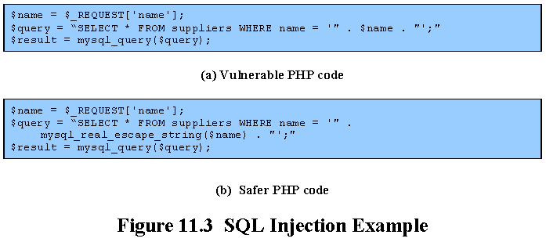
This query works fine if the input $name = Bob； but if the input is $name = Bob'; drop table suppliers, then the query becomes
SELECT * FROM suppliers WHERE name = ‘Bob‘; drop table suppliers;
The database views this line as 2 separate SQL statements: first select all entries with name Bob, then delete the entire supplier table.
mysql_real_escape_string() prepends backslashes to the some special characters, including \n, \r, \, ', "
Query becomes SELECT * FROM suppliers WHERE name = ‘Bob\‘\; drop table suppliers’
It looks for a database entry with name matching “Bob’; drop table suppliers”, and returns null.
Or, perform input validation:
die "The specified name contains illegal characters!“ unless ($name =~ /^\w+$/)
But this does not handle the name O’Connor
Notes:
Another widely exploited variant of this attack is SQL injection . In this attack,
the user-supplied input is used to construct a SQL request to retrieve information
from a database. Consider the excerpt of PHP code from a CGI script shown in
Figure 11.3a . It takes a name provided as input to the script, typically from a form
field similar to that shown in Figure 11.2b . It uses this value to construct a request
to retrieve the records relating to that name from the database. The vulnerability in
this code is very similar to that in the command injection example. The difference
is that SQL metacharacters are used, rather than shell metacharacters. If a suitable
name is provided, for example, Bob, then the code works as intended, retrieving
the desired record. However, an input such as Bob'; drop table suppliers
results in the specified record being retrieved, followed by deletion of the entire
table! This would have rather unfortunate consequences for subsequent users. To
prevent this type of attack, the input must be validated before use. Any metacharacters
must either be escaped, canceling their effect, or the input rejected entirely.
Given the widespread recognition of SQL injection attacks, many languages used
by CGI scripts contain functions that can sanitize any input that is subsequently
included in a SQL request. The code shown in Figure 11.3b illustrates the use of a
suitable PHP function to correct this vulnerability. Alternatively, rather than constructing SQL statements
directly by concatenating values, recent advisories recommend the use of SQL
placeholders or parameters to securely build SQL statements. Combined with the
use of stored procedures, this can result in more robust and secure code.

Slide 13
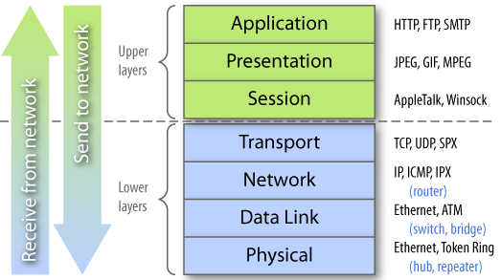
SQLi is Application-Level Attack
Not detectable by lower-layer defense mechanisms such as firewalls

Slide 14
SQLi Countermeasures
Defensive coding
Parameterized query insertion
SQL DOM
Detection
Signature based
Anomaly based
Code analysis
Run-time prevention
Check queries at runtime to see if they conform to a model of expected queries
Notes:
Because SQLi attacks are so prevalent, damaging, and varied both by attack avenue and
type, a single countermeasure is insufficient. Rather an integrated set of techniques
is necessary. In this section, we provide a brief overview of the types of countermeasures
that are in use or being researched, using the classification in [SHAR13].
These countermeasures can be classified into three types: defensive coding, detection,
and run-time prevention.
Many SQLi attacks succeed because developers have used insecure coding
practices. Thus, defensive coding is an effective way to dramatically reduce the
threat from SQLi. Examples of defensive coding include the following:
• Manual defensive coding practices: A common vulnerability exploited by
SQLi attacks is insufficient input validation. The straightforward solution for
eliminating these vulnerabilities is to apply suitable defensive coding practices.
An example is input type checking, to check that inputs that are supposed to
be numeric contain no characters other than digits. This type of technique
can avoid attacks based on forcing errors in the database management system.
Another type of coding practice is one that performs pattern matching to try
to distinguish normal input from abnormal input.
• Parameterized query insertion: This approach attempts to prevent SQLi by
allowing the application developer to more accurately specify the structure
of an SQL query, and pass the value parameters to it separately such that any
unsanitary user input is not allowed to modify the query structure.
• SQL DOM: SQL DOM is a set of classes that enables automated data type
validation and escaping [MCCL05]. This approach uses encapsulation of
database queries to provide a safe and reliable way to access databases. This
changes the query-building process from an unregulated one that uses string
concatenation to a systematic one that uses a type-checked API. Within the
API, developers are able to systematically apply coding best practices such as
input filtering and rigorous type checking of user input.
A variety of detection methods have been developed, including the following:
• Signature based: This technique attempts to match specific attack patterns.
Such an approach must be constantly updated and may not work against self-modifying
attacks.
• Anomaly based: This approach attempts to define normal behavior and then
detect behavior patterns outside the normal range. A number of approaches
have been used. In general terms, there is a training phase, in which the system
learns the range of normal behavior, followed by the actual detection phase.
• Code analysis: Code analysis techniques involve the use of a test suite to
detect SQLi vulnerabilities. The test suite is designed to generate a wide range
of SQLi attacks and assess the response of the system.
Finally, a number of run-time prevention techniques have been developed as
SQLi countermeasures. These techniques check queries at runtime to see if they
conform to a model of expected queries. Various automated tools are available for
this purpose [CHAN12, SHAR13].

Slide 15
Database Access Control
Database access control system determines:
If the user has access to the entire database or just portions of it
What access rights the user has (create, insert, delete, update, read, write)
Can support a range of administrative policies
Centralized administration
Small number of privileged users may grant and revoke access rights
Ownership-based administration
The creator of a table may grant and revoke access rights to the table
Decentralized administration
The owner of the table may grant and revoke authorization rights to other users, allowing them to grant and revoke access rights to the table
Notes:
Commercial and open-source DBMSs typically provide an access control capability
for the database. The DBMS operates on the assumption that the computer system
has authenticated each user. As an additional line of defense, the computer system
may use the overall access control system described in Chapter 4 to determine
whether a user may have access to the database as a whole. For users who are
authenticated and granted access to the database, a database access control system
provides a specific capability that controls access to portions of the database.
Commercial and open-source DBMSs provide discretionary or role-based
access control. We defer a discussion of mandatory access control considerations
to Chapter 13 . Typically, a DBMS can support a range of administrative policies,
including the following:
• Centralized administration: A small number of privileged users may grant and
revoke access rights.
• Ownership-based administration: The owner (creator) of a table may grant
and revoke access rights to the table.
• Decentralized administration: In addition to granting and revoking access rights
to a table, the owner of the table may grant and revoke authorization rights to
other users, allowing them to grant and revoke access rights to the table.
As with any access control system, a database access control system distinguishes
different access rights, including create, insert, delete, update, read, and write. Some
DBMSs provide considerable control over the granularity of access rights. Access
rights can be to the entire database, to individual tables, or to selected rows or columns
within a table. Access rights can be determined based on the contents of a table entry.
For example, in a personnel database, some users may be limited to seeing salary
information only up to a certain maximum value. And a department manager may
only be allowed to view salary information for employees in his or her department.

Slide 16
SQL Access Controls
Two commands for managing access rights:
GRANT and REVOKE
Typical access rights are:
Select
Insert
Update
Delete
References
Examples:
GRANT SELECT on ANY TABLE to Alice
It enables user Alice to query any table in the database; but Alice cannot further propagate the access to other users, due to lack of “WITH GRANT OPTION” (similar to * in Access Control Matrix in CH05)
REVOKE SELECT on ANY TABLE from Alice
Revokes the SELECT right from Alice
（This is Discretionary Access Control）
GRANT { privileges | role }
[ON table]
TO { user | role | PUBLIC }
[IDENTIFIED BY password]
[WITH GRANT OPTION]
REVOKE { privileges | role }
[ON table]
FROM { user | role | PUBLIC }
Notes:
SQL provides two commands for managing access rights, GRANT and REVOKE.
For different versions of SQL, the syntax is slightly different. In general terms, the
GRANT command has the following syntax:
GRANT { privileges | role }
[ON table]
TO { user | role | PUBLIC }
[IDENTIFIED BY password]
[WITH GRANT OPTION]
This command can be used to grant one or more access rights or can be used
to assign a user to a role. For access rights, the command can optionally specify that
it applies only to a specified table. The TO clause specifies the user or role to which
the rights are granted. A PUBLIC value indicates that any user has the specified
access rights. The optional IDENTIFIED BY clause specifies a password that
must be used to revoke the access rights of this GRANT command. The GRANT
OPTION indicates that the grantee can grant this access right to other users, with or
without the grant option.
As a simple example, consider the following statement.
GRANT SELECT ON ANY TABLE TO ricflair
This statement enables user ricflair to query any table in the database.
Different implementations of SQL provide different ranges of access rights.
The following is a typical list:
• Select: Grantee may read entire database; individual tables; or specific
columns in a table.
• Insert: Grantee may insert rows in a table; or insert rows with values for specific
columns in a table.
• Update: Semantics is similar to INSERT.
• Delete: Grantee may delete rows from a table.
• References: Grantee is allowed to define foreign keys in another table that
refer to the specified columns.
The REVOKE command has the following syntax:
REVOKE { privileges | role }
[ON table]
FROM { user | role | PUBLIC }
Thus, the following statement revokes the access rights of the preceding example:
REVOKE SELECT ON ANY TABLE FROM ricflair

Slide 17
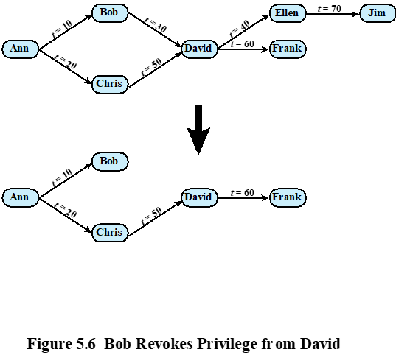
Cascaded Grants

Slide 18
Cascaded Grants Explanations
The revocation of privileges is cascaded: when user A revokes an access right, any cascaded access right is also revoked, unless that access right would exist even if the original grant from A had never occurred.
The figure indicates that Ann grants the access right to Bob at time t = 10 and to Chris at time t = 20. Assume that the grant option is always used. Thus, Bob is able to grant the access right to David at t = 30. Chris redundantly grants the access right to David at t = 50. Meanwhile, David grants the right to Ellen, who in turn grants it to Jim; and subsequently David grants the right to Frank.
if Ann revokes the access right to Bob and Chris, then the access right is also revoked to David, Ellen, Jim, and Frank.
A complication arises when a user (David) receives the same access right multiple times.
If the grant from Bob to David at t=30 is revoked, the grants from David to Ellen at time t=40, and from Ellen to Jim at t=70, are also revoked, since they depend on the grant from Bob to David at t=30.
But the grant from David to Frank at t=60 remains, since it depends on the grant from Chris to David at t=50.
Notes:
The grant option enables an access right to cascade through a number of users.We
consider a specific access right and illustrate the cascade phenomenon in Figure 5.4 .
The figure indicates that Ann grants the access right to Bob at time t = 10 and to
Chris at time t = 20. Assume that the grant option is always used. Thus, Bob is able
to grant the access right to David at t = 30. Chris redundantly grants the access right
to David at t = 50. Meanwhile, David grants the right to Ellen, who in turn grants it
to Jim; and subsequently David grants the right to Frank.
Just as the granting of privileges cascades from one user to another using
the grant option, the revocation of privileges also cascaded. Thus, if Ann
revokes the access right to Bob and Chris, then the access right is also revoked
to David, Ellen, Jim, and Frank. A complication arises when a user receives the
same access right multiple times, as happens in the case of David. Suppose that
Bob revokes the privilege from David. David still has the access right because
it was granted by Chris at t = 50. However, David granted the access right to
Ellen after receiving the right, with grant option, from Bob but prior to receiving
it from Chris. Most implementations dictate that in this circumstance, the access
right to Ellen and therefore Jim is revoked when Bob revokes the access right
to David. This is because at t = 40, when David granted the access right to
Ellen, David only had the grant option to do this from Bob. When Bob revokes
the right, this causes all subsequent cascaded grants that are traceable solely
to Bob via David to be revoked. Because David granted the access right
to Frank after David was granted the access right with grant option from Chris,
the access right to Frank remains. These effects are shown in the lower portion of
Figure 5.6 .
To generalize, the convention followed by most implementations is as follows.
When user A revokes an access right, any cascaded access right is also revoked,
unless that access right would exist even if the original grant from A had never
occurred. This convention was first proposed in [GRIF76].

Slide 19
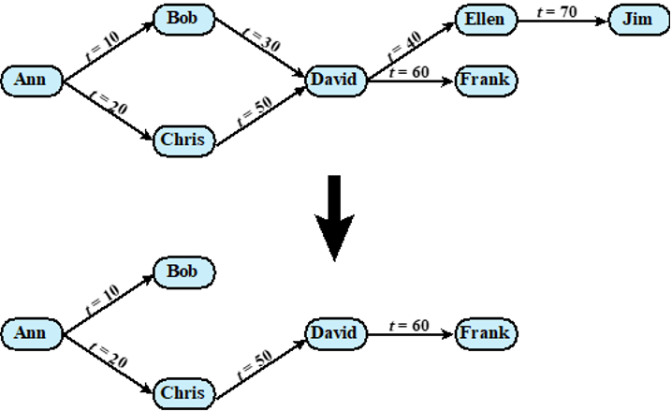
Cascaded Grants Quiz
Q: If the grant from Chris to David at t=30 is revoked at time 65, what happens to downstream grants?
ANS: None of the downstream grants will be revoked, since they now depend on the grant from Bob to David at t=10, not the grant from Chris to David at t=30
Q: If the grant from Ann to Chris at t=20 is revoked at time 65, what happens to downstream grants?
A: The grant from Chris to David at t=30 will be revoked; all other grants remain
Q: If the grant from Ann to Bob at t=10 is revoked at time 65, what happens to downstream grants?
A: The grant from Bob to David, from David to Ellen, and from Ellen to Jim will be revoked; all other grants remain

Slide 20
Role-Based Access Control (RBAC)
RBAC is a natural fit for database access control.
Unlike a file system associated with a single or a few applications, a database system often supports dozens of applications. An individual user may use a variety of applications to perform a variety of tasks, each of which requires its own set of privileges
RBAC eases administrative burden and improves security
A database RBAC needs to provide the following capabilities:
Create and delete roles
Define permissions for a role
Assign and cancel assignment of users to roles
Categories of database users:
Application owner
End user
An end user who operates on database objects via a particular application but does not own any of the database objects
Administrator
User who has administrative responsibility for part or all of the database
An end user who owns database objects as part of an application
Notes:
A role-based access control (RBAC) scheme is a natural fit for database access
control. Unlike a file system associated with a single or a few applications, a
database system often supports dozens of applications. In such an environment,
an individual user may use a variety of applications to perform a variety of tasks,
each of which requires its own set of privileges. It would be poor administrative
practice to simply grant users all of the access rights they require for all the tasks
they perform. RBAC provides a means of easing the administrative burden and
improving security.
In a discretionary access control environment, we can classify database users
in three broad categories:
• Application owner: An end user who owns database objects (tables, columns,
rows) as part of an application. That is, the database objects are generated by
the application or are prepared for use by the application.
End user other than application owner: An end user who operates on database
objects via a particular application but does not own any of the database objects.
• Administrator: User who has administrative responsibility for part or all of the
database.
We can make some general statements about RBAC concerning these
three types of users. An application has associated with it a number of tasks,
with each task requiring specific access rights to portions of the database.
For each task, one or more roles can be defined that specify the needed access
rights. The application owner may assign roles to end users. Administrators are
responsible for more sensitive or general roles, including those having to do
with managing physical and logical database components, such as data files,
users, and security mechanisms. The system needs to be set up to give certain
administrators certain privileges. Administrators in turn can assign users to
administrative-related roles.
A database RBAC facility needs to provide the following capabilities:
• Create and delete roles.
• Define permissions for a role.
• Assign and cancel assignment of users to roles.

Slide 21
Table 5.2 Fixed Roles in Microsoft SQL Server

Slide 22
Inference: performing authorized queries and deducing unauthorized information from the legitimate responses
received.
Notes:
Inference, as it relates to database security, is the process of performing authorized
queries and deducing unauthorized information from the legitimate responses
received. The inference problem arises when the combination of a number of
data items is more sensitive than the individual items, or when a combination of
data items can be used to infer data of a higher sensitivity. Figure 5.7 illustrates
the process. The attacker may make use of nonsensitive data as well as metadata.
Metadata refers to knowledge about correlations or dependencies among data
items that can be used to deduce information not otherwise available to a
particular user. The information transfer path by which unauthorized data is
obtained is referred to as an inference channel .

Slide 23
Inference Attack Examples
Consider a database of student grades with schema (StudentID, Standing (junior or senior), Exam Score). Attacker wants to find exam score of some student. Any student should be able to query for the average exam score
Example 1:
The target student Alice takes the exam late
Attacker queries for the average scores before and after Alice takes the exam, then calculate Alice’s score
Example 2:
Only one student Bob has junior standing in a class full of seniors
Attacker queries for the average score of all students with junior standing. This query discloses core of Bob

Slide 24
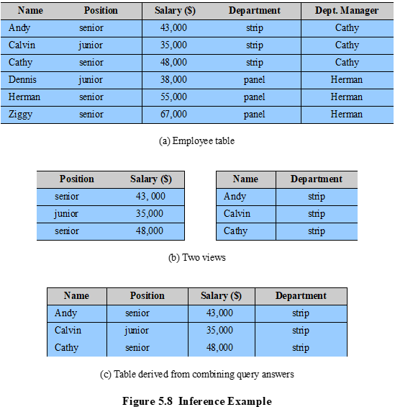
Inference Attack Examples cont’d
Each employee’s salary should be confidential
RBAC constraint: Name and Salary cannot be accessed together in the same query.
But a user who knows
1. the structure of the Employee table and
2. the view tables maintain the same row order as the Employee table
is able to merge the two views in (b) to construct the table shown in (c)
Notes:
In general terms, two inference techniques can be used to derive additional
information: analyzing functional dependencies between attributes within a table
or across tables, and merging views with the same constraints.
An example of the latter shown in Figure 5.8 , illustrates
the inference problem.
Users of these views are not authorized to access the relationship between
Name and Salary. A user who has access to either or both views cannot infer
the relationship by functional dependencies. That is, there is not a functional
relationship between Name and Salary such that knowing Name and perhaps other
information is sufficient to deduce Salary. However, suppose the two views
are created with the access constraint that Name and Salary cannot be accessed
together. A user who knows the structure of the Employee table and who knows
that the view tables maintain the same row order as the Employee table is then
able to merge the two views to construct the table shown in Figure 5.8c. This
violates the access control policy that the relationship of attributes Name and
Salary must not be disclosed.

Slide 25
Solution
Construct three tables, which include the following information:
Employees (Emp#, Name, Address)
Salaries (S#, Salary)
Emp-Salary (Emp#, S#)
Each line consists of the table name followed by a list of column names for that table. In this case, each employee is assigned a unique employee number (Emp#) and a unique salary number (S#). The Employees table and the Salaries table are accessible to the Clerk role, but the Emp-Salary table is only available to the Administrator role. In this structure, the sensitive relationship between employees and salaries is protected from users assigned the Clerk role.
Another inference channel: suppose that we want to add a new attribute, employee start date, which is not sensitive. This could be added to the Salaries table as follows:
Employees (Emp#, Name, Address)
Salaries (S#, Salary, Start-Date)
Emp-Salary (Emp#, S#)
However, an employee’s start date is an easily observable or discoverable attribute of an employee. Thus a user in the Clerk role may be able to infer the employee’s name. This would compromise the relationship between employee and salary.
A straightforward way to remove the inference channel is to add the start-date column to the Employees table instead of the Salaries table.
Notes:
Consider a database containing personnel information,
including names, addresses, and salaries of employees. Individually, the name,
address, and salary information is available to a subordinate role, such as
Clerk, but the association of names and salaries is restricted to a superior role,
such as Administrator. This is similar to the problem illustrated in Figure 5.8.
One solution to this problem is to construct three tables, which include the
following information:
Employees (Emp#, Name, Address)
Salaries (S#, Salary)
Emp-Salary (Emp#, S#)
where each line consists of the table name followed by a list of column names for that
table. In this case, each employee is assigned a unique employee number (Emp#)
and a unique salary number (S#). The Employees table and the Salaries table
are accessible to the Clerk role, but the Emp-Salary table is only available to the
Administrator role. In this structure, the sensitive relationship between employees
and salaries is protected from users assigned the Clerk role. Now suppose that we
want to add a new attribute, employee start date, which is not sensitive. This could
be added to the Salaries table as follows:
Employees (Emp#, Name, Address)
Salaries (S#, Salary, Start-Date)
Emp-Salary (Emp#, S#)
However, an employee’s start date is an easily observable or discoverable
attribute of an employee. Thus a user in the Clerk role should be able to infer (or
partially infer) the employee’s name. This would compromise the relationship between
employee and salary. A straightforward way to remove the inference channel is to
add the start-date column to the Employees table rather than to the Salaries table.

Slide 26
Inference Detection
The first inference problem, that it was possible to infer the relationship between employee and salary, can be detected through analysis of the data structures and security constraints.
However, the second inference problem, in which the start-date column was added to the Salaries table, cannot be detected using only the information stored in the database. In particular, the database does not indicate that the employee name can be inferred from the start date.
Need human understanding of application semantics

Slide 27
Two Approaches to Inference Detection
During database design
Remove an inference channel by altering the database structure or by changing the access control regime to prevent inference
Techniques in this category often result in unnecessarily stricter access controls that reduce availability
Inference detection at query time
Seek to eliminate an inference channel violation during a query or series of queries
If an inference channel is detected, the query is denied or altered
Notes:
In general terms, there are two approaches to dealing with the threat of
disclosure by inference:
• Inference detection during database design: This approach removes an
inference channel by altering the database structure or by changing the
access control regime to prevent inference. Examples include removing
data dependencies by splitting a table into multiple tables or using more
fine-grained access control roles in an RBAC scheme. Techniques in
this category often result in unnecessarily stricter access controls that
reduce availability.
• Inference detection at query time: This approach seeks to eliminate an
inference channel violation during a query or series of queries. If an inference
channel is detected, the query is denied or altered.
For either of the preceding approaches, some inference detection
algorithm is needed. This is a difficult problem and the subject of ongoing
research. To give some appreciation of the difficulty, we present an example
taken from [LUNT89].
The first security problem indicated in this sample, that it was possible to infer
the relationship between employee and salary, can be detected through analysis
of the data structures and security constraints that are available to the DBMS.
However, the second security problem, in which the start-date column was added
to the Salaries table, cannot be detected using only the information stored in the
database. In particular, the database does not indicate that the employee name can
be inferred from the start date.
In the general case of a relational database, inference detection is a complex
and difficult problem. For multilevel secure databases, discussed in Chapter 13 ,
and statistical databases, discussed in the next section, progress has been made in
devising specific inference detection techniques.

Slide 28
Database Encryption
The database is typically the most valuable information resource for any organization, protected by multiple layers of security
Firewalls, authentication, general access control systems, DB access control systems
Encryption becomes the last line of defense in database security. Can be applied to the entire database, at the record level, the attribute level, or level of the individual field
Disadvantages to encryption:
Key management
Authorized users must have access to the decryption key for the data for which they have access
Inflexibility
When part or all of the database is encrypted it becomes more difficult to perform record searching
Notes:
The database is typically the most valuable information resource for any organization
and is therefore protected by multiple layers of security, including firewalls,
authentication mechanisms, general access control systems, and database access
control systems. In addition, for particularly sensitive data, database encryption is
warranted and often implemented. Encryption becomes the last line of defense in
database security.
There are two disadvantages to database encryption:
• Key management: Authorized users must have access to the decryption key for
the data for which they have access. Because a database is typically accessible
to a wide range of users and a number of applications, providing secure keys
to selected parts of the database to authorized users and applications is a
complex task.
• Inflexibility: When part or all of the database is encrypted, it becomes more
difficult to perform record searching.
Encryption can be applied to the entire database, at the record level (encrypt
selected records), at the attribute level (encrypt selected columns), or at the level of
the individual field.
A number of approaches have been taken to database encryption. In this
section, we look at a representative approach for a multiuser database.
A DBMS is a complex collection of hardware and software. It requires a large
storage capacity and requires skilled personnel to perform maintenance, disaster
protection, update, and security. For many small and medium-sized organizations,
an attractive solution is to outsource the DBMS and the database to a service
provider. The service provider maintains the database off site and can provide high
availability, disaster prevention, and efficient access and update. The main concern
with such a solution is the confidentiality of the data.

Slide 29
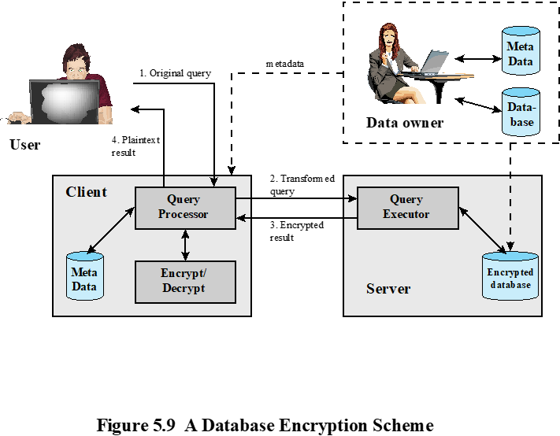
A Database Encryption Scheme
Data owner: organization that produces data to be made available for controlled release
User: human entity that presents queries to the system
Client: frontend that transforms user queries into queries on the encrypted data stored on the server
Server: an organization that receives the encrypted data from a data owner and makes them available for distribution to clients
Notes:
A straightforward solution to the security problem in this context is to encrypt
the entire database and not provide the encryption/decryption keys to the service
provider. This solution by itself is inflexible. The user has little ability to access
individual data items based on searches or indexing on key parameters, but rather
would have to download entire tables from the database, decrypt the tables, and
work with the results. To provide more flexibility, it must be possible to work with
the database in its encrypted form.
An example of such an approach, depicted in Figure 5.9 , is reported in
[DAMI05] and [DAMI03]. A similar approach is described in [HACI02]. Four
entities are involved:
• Data owner: An organization that produces data to be made available for
controlled release, either within the organization or to external users.
• User: Human entity that presents requests (queries) to the system. The user
could be an employee of the organization who is granted access to the database
via the server, or a user external to the organization who, after authentication,
is granted access.
Client: Frontend that transforms user queries into queries on the encrypted
data stored on the server.
• Server: An organization that receives the encrypted data from a data owner
and makes them available for distribution to clients. The server could in
fact be owned by the data owner but, more typically, is a facility owned and
maintained by an external provider.

Slide 30
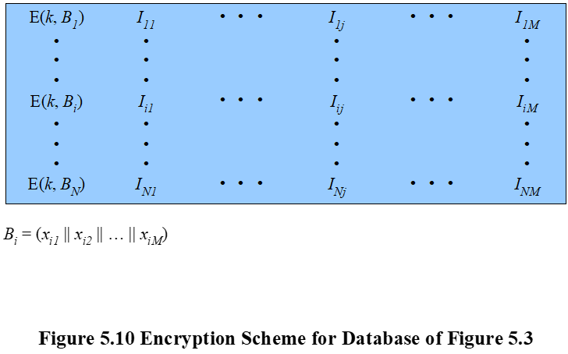
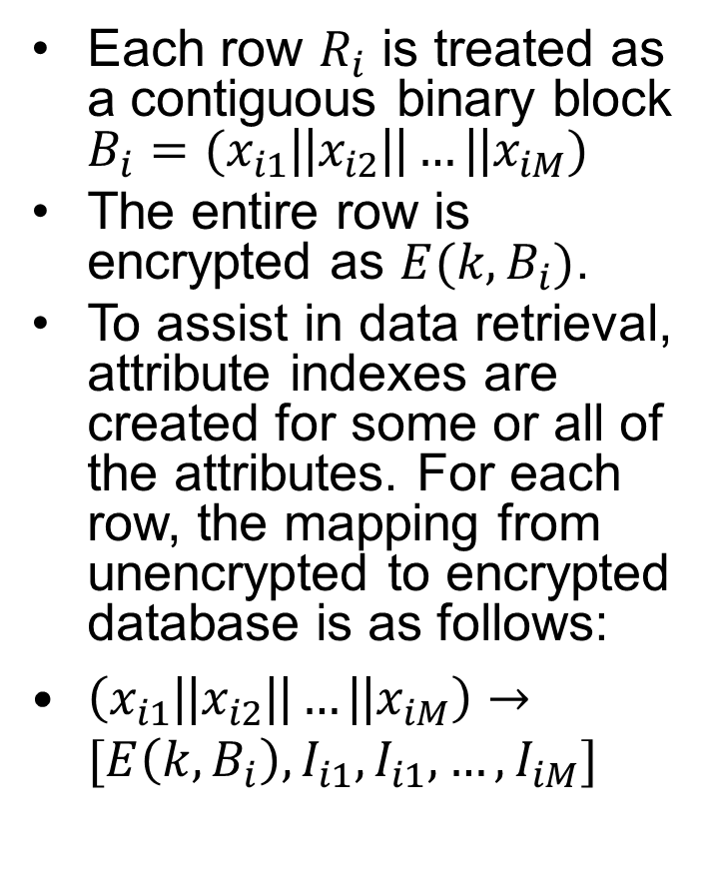
Each row $R_{i}$ is treated as a contiguous binary block $B_{i}=(x_{i1}\text{||}x_{i2}\text{||}…\text{||}x_{iM})$
The entire row is encrypted as $E(k,B_{i})$.
To assist in data retrieval, attribute indexes are created for some or all of the attributes. For each row, the mapping from unencrypted to encrypted database is as follows:
$\left(x_{i1}\text{||}x_{i2}\text{||}…\text{||}x_{iM}\right)→[E\left(k,B_{i}\right), I_{i1},I_{i1},…,I_{iM}]$
Notes:
Each record (row)
of a table in the database is encrypted as a block. Referring to the abstract model
of a relational database in Figure 5.3, each row R_{i} is treated as a contiguous block
B_{i} = (x_{i1} || x_{i2} ||…|| x_{iM} ). Thus, each attribute value in R_{i} , regardless of whether it
is text or numeric, is treated as a sequence of bits, and all of the attribute values
for that row are concatenated together to form a single binary block. The entire
row is encrypted, expressed as E (k, B_{i} ) = E (k, (x_{i1} || x_{i2} ||…|| x_{iM} )). To assist in data
retrieval, attribute indexes are associated with each table. For some or all of the
attributes an index value is created. For each row R_{i} of the unencrypted database, the
mapping is as follows (see Figure 5.10):
(x_{i1}, x_{i2}, … , x_{iM} ) →[E (k, B_{i}), I_{i1}, I_{i2} , … , I_{iM} ]
For each row in the original database, there is one row in the encrypted database.
The index values are provided to assist in data retrieval. We can proceed as
follows. For any attribute, the range of attribute values is divided into a set of non-overlapping
partitions that encompass all possible values, and an index value is
assigned to each partition.

Slide 31
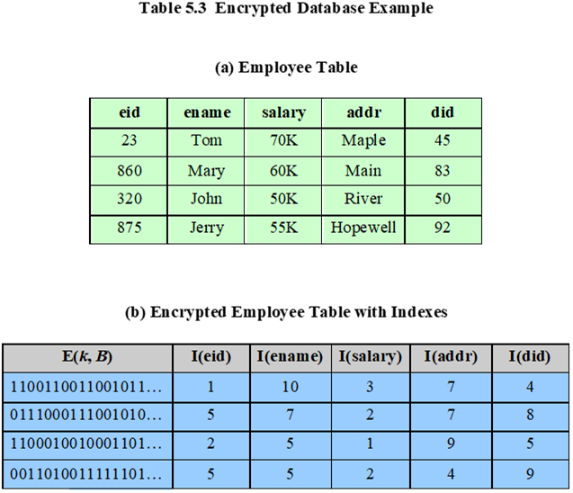
Notes:
Table 5.3 provides an example of this mapping. Suppose employee ID (eid )
values lie in the range [1, 1000]. We can divide these values into five partitions:
[1, 200], [201, 400], [401, 600], [601, 800], and [801, 1000]; then assign index values 1,
2, 3, 4, and 5, respectively. For a text field, we can derive an index from the first letter
of the attribute value. For the attribute ename , let us assign index 1 to values starting
with A or B, index 2 to values starting with C or D, and so on. Similar partitioning
schemes can be used for each of the attributes. Table 5.3b shows the resulting table.
The values in the first column represent the encrypted values for each row. The actual
values depend on the encryption algorithm and the encryption key. The remaining
columns show index values for the corresponding attribute values. The mapping functions
between attribute values and index values constitute metadata that are stored
at the client and data owner locations but not at the server.
This arrangement provides for more efficient data retrieval. Suppose, for
example, a user requests records for all employees with eid 6 < 300. The query processor
requests all records with I (eid ) = 2. These are returned by the server. The query
processor decrypts all rows returned, discards those that do not match the original
query, and returns the requested unencrypted data to the user.
The indexing scheme just described does provide a certain amount of information
to an attacker, namely a rough relative ordering of rows by a given attribute. To
obscure such information, the ordering of indexes can be randomized. For example,
the eid values could be partitioned by mapping [1, 200], [201, 400], [401, 600],
[601, 800], and [801, 1000] into 2, 3, 5, 1, and 4, respectively. Because the metadata are
not stored at the server, an attacker could not gain this information from the server.
Other features may be added to this scheme. To increase the efficiency of accessing
records by means of the primary key, the system could use the encrypted value of
the primary key attribute values, or a hash value. In either case, the row corresponding
to the primary key value could be retrieved individually. Different portions of the
database could be encrypted with different keys, so users would only have access to
that portion of the database for which they had the decryption key. This latter scheme
could be incorporated into a role-based access control system.

Slide 32
Table 5.3 Explanations
Suppose employee ID (eid ) values lie in the range [1, 1000]. We can divide these values into five partitions: [1, 200], [201, 400], [401, 600], [601, 800], and [801, 1000], assigned index values 1, 2, 3, 4, and 5, respectively. For a text field, we can derive an index from the first letter of the attribute value. For the attribute ename , let us assign index 1 to values starting with A or B, index 2 to values starting with C or D, and so on. Similar partitioning schemes can be used for each of the attributes.
In Table 5.3b, the values in the first column represent the encrypted values for each row. The remaining columns show index values for the corresponding attribute values. The mapping functions between attribute values and index values constitute metadata that are stored at the client and data owner locations but not at the server.
This arrangement provides for more efficient data retrieval. Suppose, for example, a user requests records for all employees with eid 6 < 300. The query processor requests all records with I (eid ) = 2. These are returned by the server. The query processor decrypts all rows returned, discards those that do not match the original query, and returns the requested unencrypted data to the user.
The indexing scheme provides some information to an attacker, namely a rough relative ordering of rows by a given attribute. To obscure such information, the ordering of indexes can be randomized. For example, the eid values could be partitioned by mapping [1, 200], [201, 400], [401, 600], [601, 800], and [801, 1000] into 2, 3, 5, 1, and 4, respectively. Because the metadata are not stored at the server, an attacker could not gain this information from the server.
Notes:
Other features may be added to this scheme. To increase the efficiency of accessing
records by means of the primary key, the system could use the encrypted value of
the primary key attribute values, or a hash value. In either case, the row corresponding
to the primary key value could be retrieved individually. Different portions of the
database could be encrypted with different keys, so users would only have access to
that portion of the database for which they had the decryption key. This latter scheme
could be incorporated into a role-based access control system.

Slide 33
Cloud Computing:
NIST defines cloud computing, in NIST SP-800-145 (The NIST Definition of Cloud Computing, September 2011) as follows:
“Cloud computing: A model for enabling ubiquitous, convenient, on-demand network access to a shared pool of configurable computing resources (e.g., networks, servers, storage, applications, and services) that can be rapidly provisioned and released with minimal management effort or service provider interaction. This cloud model promotes availability and is composed of five essential characteristics,
three service models, and four deployment models.”
Notes:
NIST defines cloud computing, in NIST SP-800-145 (The NIST Definition of Cloud
Computing ) as follows:
Cloud computing: A model for enabling ubiquitous, convenient, on-demand network
access to a shared pool of configurable computing resources (e.g., networks,
servers, storage, applications, and services) that can be rapidly provisioned and
released with minimal management effort or service provider interaction. This
cloud model promotes availability and is composed of five essential characteristics,
three service models, and four deployment models.

Slide 34
Notes:
The definition refers to various models and characteristics, whose relationship
is illustrated in Figure 13.1. The essential characteristics of cloud computing include
the following:
• Broad network access: Capabilities are available over the network and accessed
through standard mechanisms that promote use by heterogeneous thin or thick
client platforms (e.g., mobile phones, laptops, and tablets) as well as other traditional
or cloud-based software services.
• Rapid elasticity: Cloud computing gives you the ability to expand and reduce
resources according to your specific service requirement. For example, you may
need a large number of server resources for the duration of a specific task. You
can then release these resources upon completion of the task.
• Measured service: Cloud systems automatically control and optimize resource
use by leveraging a metering capability at some level of abstraction appropriate
to the type of service (e.g., storage, processing, bandwidth, and active user
accounts). Resource usage can be monitored, controlled, and reported, providing
transparency for both the provider and consumer of the utilized service.
• On-demand self-service: A cloud service consumer (CSC) can unilaterally
provision computing capabilities, such as server time and network storage, as
needed automatically without requiring human interaction with each service
provider. Because the service is on demand, the resources are not permanent
parts of the consumer’s IT infrastructure.
Resource pooling: The provider’s computing resources are pooled to serve
multiple CSCs using a multitenant model, with different physical and virtual
resources dynamically assigned and reassigned according to consumer demand.
There is a degree of location independence, in that the CSC generally has no
control or knowledge of the exact location of the provided resources, but may
be able to specify location at a higher level of abstraction (e.g., country, state,
or datacenter). Examples of resources include storage, processing, memory,
network bandwidth, and virtual machines (VMs). Even private clouds tend to
pool resources between different parts of the same organization.

Slide 35
Cloud Service Models
Three service models: Platform as a Service (PaaS), Infrastructure as a Service (IaaS), Software as a Service (SaaS)
Notes:
NIST SP 800-145 defines three service models , which can be viewed as nested service alternatives:
software as a service (SaaS), platform as a service (PaaS), and infrastructure
as a service (IaaS).

Slide 36

Three Cloud Service Models
Software as a service (SaaS): Provides service in the form of application software running on and accessible in the cloud
e.g., webmail (Gmail, QQ mail, 163 mail…)
Platform as a service (PaaS): Provides service in the form of a platform, including hardware infrastructure, software building blocks, development tools, runtime environments, and other tools that assist in deploying the customer’s own applications
e.g., Google App Engine
Infrastructure as a service (IaaS): Provides the customer access to the hardware infrastructure, including processing, storage, networks, and other computing resources so that the customer is able to deploy and run arbitrary software
e.g., Aliyun

Slide 37
NIST Deployment Models
Public cloud
The cloud infrastructure is made available to the general public or a large industry group and is owned by an organization selling cloud services
The cloud provider is responsible both for the cloud infrastructure and for the control of data and operations within the cloud
Private cloud
The cloud infrastructure is operated solely for an organization
It may be managed by the organization or a third party and may exist on premise or off premise
The cloud provider is responsible only for infrastructure and not for control
Community cloud
The cloud infrastructure is shared by several organizations and supports a specific community that has shared concerns
It may be managed by the organizations or a third party and may exist on premise or off premise
Hybrid cloud
The cloud infrastructure is a composition of two or more clouds
Notes:
NIST defines four deployment models :
• Public cloud: The cloud infrastructure is made available to the general public
or a large industry group and is owned by an organization selling cloud
services. The cloud provider is responsible both for the cloud infrastructure
and for the control of data and operations within the cloud.
• Private cloud: The cloud infrastructure is operated solely for an organization.
It may be managed by the organization or a third party and may exist on
premise or off premise. The cloud provider is responsible only for the
infrastructure and not for the control.
• Community cloud: The cloud infrastructure is shared by several organizations
and supports a specific community that has shared concerns (e.g., mission,
security requirements, policy, and compliance considerations). It may be
managed by the organizations or a third party and may exist on premise or
off premise.
• Hybrid cloud: The cloud infrastructure is a composition of two or more
clouds (private, community, or public) that remain unique entities but
are bound together by standardized or proprietary technology that enables
data and application portability (e.g., cloud bursting for load balancing
between clouds).

Slide 38
Deployment Models Comparison
 | Private | Community | Public | Hybrid
Scalability | Limited | Limited | Very high | Very high
Security | Most secure option | Very secure | Moderately secure | Very secure
Performance | Very good | Very good | Low to medium | Good
Reliability | Very high | Very high | Medium | Medium to high
Cost | High | Medium | Low | Medium
Table 13.1
Comparison of Cloud Deployment Models
Notes:
Table 13.1 lists some of the relative strengths and weaknesses of the four cloud
deployment models.

Slide 39
Cloud Computing Reference Architecture
NIST SP-500-292 (NIST Cloud Computing Reference Architecture) establishes reference architecture, described as follows:
“The NIST cloud computing reference architecture focuses on the requirements of “what” cloud services provide, not a “how to” design solution and implementation. The reference architecture is intended to facilitate the understanding of the operational intricacies in cloud computing. It does not represent the system architecture of a specific cloud computing system; instead it is a tool for describing, discussing, and developing a system-specific architecture using a common framework of reference.”
Notes:
NIST SP 500-292 (NIST Cloud Computing Reference Architecture, September 2011) establishes reference
architecture, described as follows:
The NIST cloud computing reference architecture focuses on the requirements
of “what” cloud services provide, not a “how to” design solution and implementation.
The reference architecture is intended to facilitate the understanding of
the operational intricacies in cloud computing. It does not represent the system
architecture of a specific cloud computing system; instead it is a tool for describing,
discussing, and developing a system-specific architecture using a common framework
of reference.

Slide 40
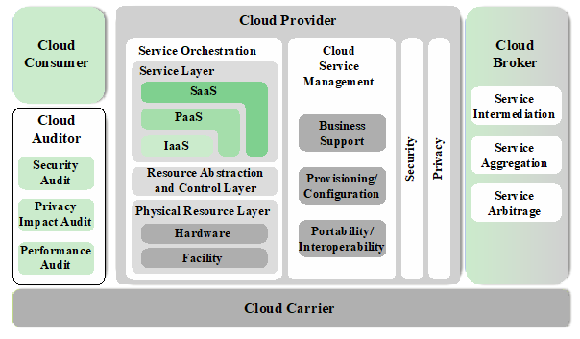
Actors in the Ref Architecture
Five major actors in terms of the roles and responsibilities:
Cloud service consumer (CSC): A person or organization that maintains a business relationship with, and uses service from, cloud providers.
Cloud service provider (CSP): A person, organization, or entity responsible for making a service available to interested parties.
Cloud auditor: A party that can conduct independent assessment of cloud services, information system operations, performance, and security of the cloud implementation.
Cloud broker: An entity that manages the use, performance, and delivery of cloud services, and negotiates relationships between CSPs and cloud consumers.
Cloud carrier: An intermediary that provides connectivity and transport of cloud services from CSPs to cloud consumers.
Notes:
The reference architecture, depicted in Figure 13.3, defines five major actors in
terms of the roles and responsibilities:
• Cloud service consumer (CSC): A person or organization that maintains a business
relationship with, and uses service from, cloud providers.
• Cloud service provider (CSP): A person, organization, or entity responsible for
making a service available to interested parties.
• Cloud auditor: A party that can conduct independent assessment of cloud services,
information system operations, performance, and security of the cloud
implementation.
• Cloud broker: An entity that manages the use, performance, and delivery of
cloud services, and negotiates relationships between CSPs and cloud consumers.
• Cloud carrier: An intermediary that provides connectivity and transport of
cloud services from CSPs to cloud consumers.
The roles of the cloud consumer and provider have already been discussed.
To summarize, a cloud service provider can provide one or more of the cloud services
to meet IT and business requirements of cloud service consumers . For each of the
three service models (SaaS, PaaS, IaaS), the CSP provides the storage and processing
facilities needed to support that service model, together with a cloud interface
for cloud service consumers. For SaaS, the CSP deploys, configures, maintains, and
updates the operation of the software applications on a cloud infrastructure so that
the services are provisioned at the expected service levels to cloud consumers. The
consumers of SaaS can be organizations that provide their members with access to
software applications, end users who directly use software applications, or software
application administrators who configure applications for end users.
For PaaS, the CSP manages the computing infrastructure for the platform and
runs the cloud software that provides the components of the platform, such as runtime
software execution stacks, databases, and other middleware components. Cloud
consumers of PaaS can employ the tools and execution resources provided by CSPs
to develop, test, deploy, and manage the applications hosted in a cloud environment.
For IaaS, the CSP acquires the physical computing resources underlying the
service, including the servers, networks, storage, and hosting infrastructure. The IaaS
CSC in turn uses these computing resources, such as a virtual machine, for their fundamental
computing needs.
The cloud carrier is a networking facility that provides connectivity and transport
of cloud services between cloud consumers and CSPs. Typically, a CSP will set
up service level agreements (SLAs) with a cloud carrier to provide services consistent
with the level of SLAs offered to cloud consumers, and may require the cloud carrier
to provide dedicated and secure connections between cloud consumers and CSPs.
A cloud broker is useful when cloud services are too complex for a cloud consumer
to easily manage. A cloud broker can offer three areas of support:
• Service intermediation: These are value-added services, such as identity management,
performance reporting, and enhanced security.
• Service aggregation: The broker combines multiple cloud services to meet consumer
needs not specifically addressed by a single CSP, or to optimize performance
or minimize cost.
• Service arbitrage: This is similar to service aggregation except that the services
being aggregated are not fixed. Service arbitrage means a broker has the flexibility
to choose services from multiple agencies. The cloud broker, for example,
can use a credit-scoring service to measure and select an agency with the best
score.
A cloud auditor can evaluate the services provided by a CSP in terms of security
controls, privacy impact, performance, and so on. The auditor is an independent entity
that can assure that the CSP conforms to a set of standards.

Slide 41
Interactions between Actors
Three types of networks.
The Data Center Network of the CSP consists of racks of high-performance servers and storage devices, interconnected with high-speed Ethernet switches.
The Enterprise Network of the CSC typically includes a number of LANs, servers, workstations, PCs, and mobile devices, with a broad range of network performance, security, and management issues.
The Cloud Carrier, which is shared with many users, cab create virtual networks with appropriate SLA and security guarantees.
Notes:
Figure 13.4 illustrates the interactions between the actors. A cloud consumer
may request cloud services from a cloud provider directly or via a cloud broker. A
cloud auditor conducts independent audits and may contact the others to collect
necessary information. This figure shows that cloud networking issues involve three
separate types of networks. For a cloud producer, the network architecture is that of
a typical large datacenter, which consists of racks of high-performance servers and
storage devices, interconnected with high-speed top-of-rack Ethernet switches. The
concerns in this context focus on virtual machine placement and movement, load
balancing, and availability issues. The enterprise network is likely to have a quite
different architecture, typically including a number of LANs, servers, workstations,
PCs, and mobile devices, with a broad range of network performance, security, and
management issues. The concern of both producer and consumer with respect to the
cloud carrier, which is shared with many users, is the ability to create virtual networks,
with appropriate SLA and security guarantees.

Slide 42
Security Issues for Cloud Computing
Security is a major consideration when augmenting or replacing on-premises systems with cloud services
Allaying security concerns is frequently a prerequisite for further discussions about migrating part or all of an organization’s computing architecture to the cloud
Availability is another major concern
Auditability of data must be ensured
Businesses should perform due diligence on security threats both from outside and inside the cloud
Cloud users are responsible for application-level security
Cloud vendors are responsible for physical security and some software security
Security for intermediate layers of the software stack is shared between users and vendors
Cloud providers must guard against theft or denial-of-service attacks by their users and users need to be protected from one another
Businesses should consider the extent to which subscribers are protected against the provider, especially in the area of inadvertent data loss
Notes:
Security is important to any computing infrastructure. Companies go to great lengths
to secure on-premises computing systems, so it is not surprising that security looms as
a major consideration when augmenting or replacing on-premises systems with cloud
services. Allaying security concerns is frequently a prerequisite for further discussions
about migrating part or all of an organization’s computing architecture to the cloud.
Availability is another major concern.
Generally speaking, such questions only arise when businesses contemplating
moving core transaction processing, such as enterprise resource planning (ERP)
systems, and other mission critical applications to the cloud. Companies have traditionally
demonstrated less concern about migrating high maintenance applications
such as e-mail and payroll to cloud service providers, even though such applications
hold sensitive information.
Auditability is another concern for many organizations. For example, in the U.S.,
many organizations must comply with Sarbanes-Oxley and/or Health and Human
Services Health Insurance Portability and Accountability Act (HIPAA) regulations.
The auditability of their data must be ensured whether it is stored on premises or
moved to the cloud.
Before moving critical infrastructure to the cloud, businesses should perform due
diligence on security threats both from outside and inside the cloud. Many of the security
issues associated with protecting clouds from outside threats are similar to those that
have traditionally faced centralized data centers. In the cloud, however, responsibility for
assuring adequate security is frequently shared among users, vendors, and any third-party
firms that users rely on for security-sensitive software or configurations. Cloud users are
responsible for application-level security. Cloud vendors are responsible for physical
security and some software security such as enforcing external firewall policies. Security
for intermediate layers of the software stack is shared between users and vendors.
A security risk that should not be overlooked by companies considering a
migration to the cloud is that posed by sharing vendor resources with other cloud
users. Cloud providers must guard against theft or denial-of-service attacks by their
users and users need to be protected from one another. Virtualization can be a powerful
mechanism for addressing these potential risks because it protects against most
attempts by users to attack one another or the provider’s infrastructure. However,
not all resources are virtualized, and not all virtualization environments are bug free.
Incorrect virtualization may allow user code to access to sensitive portions of the provider’s
infrastructure or the resources of other users. Once again, these security issues
are not unique to the cloud and are similar to those involved in managing non-cloud
data centers, where different applications need to be protected from one another.
Another security concern that businesses should consider is the extent to which
subscribers are protected against the provider, especially in the area of inadvertent data
loss. For example, in the event of provider infrastructure improvements, what happens to
hardware that is retired or replaced? It is easy to imagine a hard disk being disposed of
without being properly wiped clean of subscriber data. It is also easy to imagine permissions
bugs or errors that make subscriber data visible to unauthorized users. User-level
encryption may be an important self-help mechanism for subscribers, but businesses
should ensure that other protections are in place to avoid inadvertent data loss.

Slide 43
Risks and Countermeasures
The Cloud Security Alliance lists the following as the top cloud-specific security threats:
Abuse and nefarious use of cloud computing
Countermeasures include:
Stricter initial registration and validation processes
Enhanced credit card fraud monitoring and coordination
Comprehensive inspection of customer network traffic
Monitoring public blacklists for one’s own network blocks
Insecure interfaces and APIs
Countermeasures include:
Analyzing the security model of CSP interfaces
Ensuring that strong authentication and access controls are implemented in concert with encrypted transmission
Understanding the dependency chain associated with the API
Notes:
In general terms, security controls in cloud computing are similar to the security
controls in any IT environment. However, because of the operational models and
technologies used to enable cloud service, cloud computing may present risks that
are specific to the cloud environment. The essential concept in this regard is that
while the enterprise loses a substantial amount of control over resources, services,
and applications, it must maintain accountability for security and privacy policies.
The Cloud Security Alliance [CSA13] lists the following as the top cloud-specific
security threats:
• Abuse and nefarious use of cloud computing: For many CSPs, it is relatively
easy to register and begin using cloud services, some even offering free limited
trial periods. This enables attackers to get inside the cloud to conduct various
attacks, such as spamming, malicious code attacks, and denial of service. PaaS
providers have traditionally suffered most from this kind of attacks; however,
recent evidence shows that hackers have begun to target IaaS vendors as well.
The burden is on the CSP to protect against such attacks, but cloud service
clients must monitor activity with respect to their data and resources to detect
any malicious behavior.
Countermeasures include (1) stricter initial registration and validation
processes; (2) enhanced credit card fraud monitoring and coordination; (3) comprehensive
inspection of customer network traffic; and (4) monitoring public
blacklists for one’s own network blocks.
• Insecure interfaces and APIs: CSPs expose a set of software interfaces or APIs
that customers use to manage and interact with cloud services. The security and
availability of general cloud services is dependent upon the security of these
basic APIs. From authentication and access control to encryption and activity
monitoring, these interfaces must be designed to protect against both accidental
and malicious attempts to circumvent policy.
Countermeasures include (1) analyzing the security model of CSP interfaces;
(2) ensuring that strong authentication and access controls are implemented
in concert with encrypted transmission; and (3) understanding the
dependency chain associated with the API.
• Malicious insiders: Under the cloud computing paradigm, an organization relinquishes
direct control over many aspects of security and, in doing so, confers
an unprecedented level of trust onto the CSP. One grave concern is the risk of
malicious insider activity. Cloud architectures necessitate certain roles that are
extremely high risk. Examples include CSP system administrators and managed
security service providers.
Countermeasures include the following: (1) enforce strict supply chain
management and conduct a comprehensive supplier assessment; (2) specify
human resource requirements as part of legal contract; (3) require transparency
into overall information security and management practices, as well as
compliance reporting; and (4) determine security breach notification processes.

Slide 44
Malicious insiders
Countermeasures include:
Enforce strict supply chain management and conduct a comprehensive supplier assessment
Specify human resource requirements as part of legal contract
Require transparency into overall information security and management practices, as well as compliance reporting
Determine security breach notification processes
Shared technology issues
Countermeasures include:
Implement security best practices for installation/configuration
Monitor environment for unauthorized changes/activity
Promote strong authentication and access control for administrative access and operations
Enforce SLAs for patching and vulnerability remediation
Conduct vulnerability scanning and configuration audits
Notes:
• Malicious insiders: Under the cloud computing paradigm, an organization relinquishes
direct control over many aspects of security and, in doing so, confers
an unprecedented level of trust onto the CSP. One grave concern is the risk of
malicious insider activity. Cloud architectures necessitate certain roles that are
extremely high risk. Examples include CSP system administrators and managed
security service providers.
Countermeasures include the following: (1) enforce strict supply chain
management and conduct a comprehensive supplier assessment; (2) specify
human resource requirements as part of legal contract; (3) require transparency
into overall information security and management practices, as well as
compliance reporting; and (4) determine security breach notification processes.
Shared technology issues: IaaS vendors deliver their services in a scalable way
by sharing infrastructure. Often, the underlying components that make up this
infrastructure (CPU caches, GPUs, etc.) were not designed to offer strong isolation
properties for a multi-tenant architecture. CSPs typically approach this risk
by using isolated VMs for individual clients. This approach is still vulnerable to
attack, by both insiders and outsiders, and so can only be a part of an overall
security strategy.
Countermeasures include the following: (1) implement security best practices
for installation/configuration; (2) monitor environment for unauthorized
changes/activity; (3) promote strong authentication and access control for
administrative access and operations; (4) enforce SLAs for patching and vulnerability
remediation; and (5) conduct vulnerability scanning and configuration
audits.

Slide 45
Data loss or leakage
Countermeasures include:
Implement strong API access control
Encrypt and protect integrity of data in transit and at rest
Analyze data protection at both design and run time
Implement strong key generation, storage and management, and destruction practices
Account or service hijacking
Countermeasures include:
Prohibit the sharing of account credentials between users and services
Leverage strong two-factor authentication techniques where possible
Employ proactive monitoring to detect unauthorized activity
Understand CSP security policies and SLAs
Unknown risk profile
Countermeasures include:
Disclosure of applicable logs and data
Partial/full disclosure of infrastructure details
Monitoring and alerting on necessary information
Notes:
• Data loss or leakage: For many clients, the most devastating impact from a
security breach is the loss or leakage of data. We will address this issue in the
next section.
Countermeasures include the following: (1) implement strong API access
control; (2) encrypt and protect integrity of data in transit and at rest; (3) analyze
data protection at both design and run time; and (4) implement strong key
generation, storage and management, and destruction practices.
• Account or service hijacking: Account and service hijacking, usually with stolen
credentials, remains a top threat. With stolen credentials, attackers can often
access critical areas of deployed cloud computing services, allowing them to
compromise the confidentiality, integrity, and availability of those services.
Countermeasures include the following: (1) prohibit the sharing of account
credentials between users and services; (2) leverage strong two-factor authentication
techniques where possible; (3) employ proactive monitoring to detect
unauthorized activity; and (4) understand CSP security policies and SLAs.
• Unknown risk profile: In using cloud infrastructures, the client necessarily cedes
control to the cloud provider on a number of issues that may affect security.
Thus the client must pay attention to and clearly define the roles and responsibilities
involved for managing risks. For example, employees may deploy applications
and data resources at the CSP without observing the normal policies
and procedures for privacy, security, and oversight.
Countermeasures include (1) disclosure of applicable logs and data; (2)
partial/full disclosure of infrastructure details (e.g., patch levels and firewalls);
and (3) monitoring and alerting on necessary information.
Similar lists have been developed by the European Network and Information
Security Agency [ENIS09] and NIST SP 800-144.

Slide 46
Data Protection in the Cloud
The threat of data compromise increases in the cloud, due to the number of, and interactions between, risks and challenges that are either unique to the cloud or more dangerous because of the architectural or operational characteristics of the cloud environment
Data must be secured while at rest, in transit, and in use, and access to the data must be controlled
The client can employ encryption to protect data in transit, though this involves key management responsibilities for the CSP
The client can enforce access control techniques, but CSP is involved to some extent depending on the service model used
For data at rest, the ideal security measure is for the client to encrypt the database and only store encrypted data in the cloud, with the CSP having no access to the encryption key
Even with these precautions, corruption and other denial-of-service attacks remain a risk
Notes:
There are many ways to compromise data. Deletion or alteration of records without
a backup of the original content is an obvious example. Unlinking a record from a
larger context may render it unrecoverable, as can storage on unreliable media. Loss
of an encoding key may result in effective destruction. Finally, unauthorized parties
must be prevented from gaining access to sensitive data.
The threat of data compromise increases in the cloud, due to the number of,
and interactions between, risks and challenges that are either unique to the cloud
or more dangerous because of the architectural or operational characteristics of the
cloud environment.
Data must be secured while at rest, in transit, and in use, and access to the
data must be controlled. The client can employ encryption to protect data in transit,
though this involves key management responsibilities for the CSP. The client can
enforce access control techniques, but, again, the CSP is involved to some extent
depending on the service model used.
For data at rest, the ideal security measure is for the client to encrypt the
database and only store encrypted data in the cloud, with the CSP having no access
to the encryption key. So long as the key remains secure, the CSP has no ability to
decipher the data, although corruption and other denial-of-service attacks remain
a risk. The model depicted in Figure 5.9 works equally well when the data is stored
in a cloud.

Slide 47
Data Protection in the Cloud
Provides a unique DBMS running on a VM instance for each cloud subscriber
This gives the subscriber complete control over role definition, user authorization, and other administrative tasks related to security
Multi-instance Model
Multi-tenant Model
Provides a predefined environment for the cloud subscriber that is shared with other tenants, typically through tagging data with a subscriber identifier
Tagging gives the appearance of exclusive use of the instance, but relies on the cloud provider to establish and maintain a sound secure database environment
Notes:
Database environments used in cloud computing can vary significantly. Some
providers support a multi-instance model , which provide a unique DBMS running on
a VM instance for each cloud subscriber. This gives the subscriber complete control
over role definition, user authorization, and other administrative tasks related to
security. Other providers support a multi-tenant model, which provides a predefined
environment for the cloud subscriber that is shared with other tenants, typically
through tagging data with a subscriber identifier. Tagging gives the appearance of
exclusive use of the instance, but relies on the cloud provider to establish and maintain
a sound secure database environment.

Slide 48
Notes:
Beyond the protection and isolation of data, the cloud service provider (CSP)
needs to address the broader security considerations for the protection of its assets.
Figure
13.5a, adapted from [ENIS15], suggests a categorization of these assets for
the three cloud service models. The bottom two layers shown in the figure include
organization and facilities. Organization denotes the human resources and the policies
and procedures for maintaining the facilities and supporting the delivery of the
services. Facilities denote the physical structures and supplies such as networks, cooling,
and power supply. Above these levels are the assets specific to the provision of
services. For IaaS, the CSP maintains a hypervisor and/or OS on each of its servers, as
well as the networking software for interconnection of CSP servers and connection
to cloud service consumers (CSCs). Added to these assets for PaaS are the libraries,
middleware, and other software to support CSC applications. For SaaS, the CSP also
has application software assets for CSC use.
Figure 13.5b suggests key security tasks that are the responsibility of the CSP
and of the CSC. The lowest level of the diagram has to do with organizational issues
related to the management of its supplies and facilities. These issues will be dealt with
in Chapters 14, 15, and 17. The next level of Figure 13.5b covers the physical security
of the facility, a topic covered in Chapter 16. Above that, depending on the service
model, the CSP is responsible for the security of a range of software capabilities;
security measures in the area were addressed in Chapters 11 and 12.

Slide 49
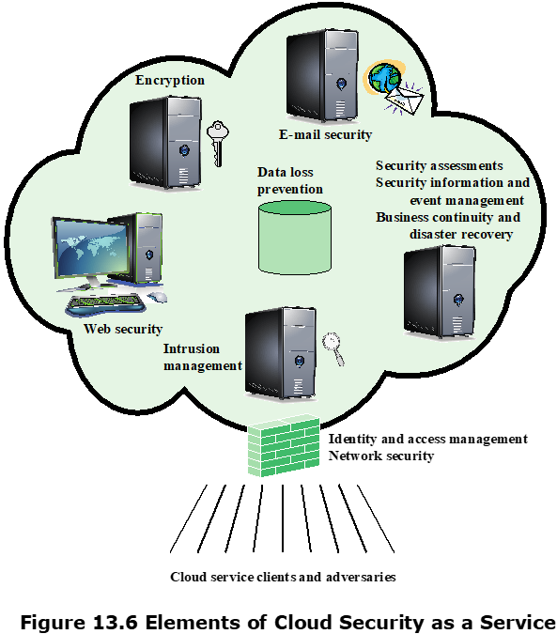
Cloud Security as a Service
Cloud Security as a Service (SecaaS), is one type of SaaS offered by a CSP.
provision of security applications and services via the cloud either to cloud-based infrastructure and software, or from the cloud to the customers’ on-premise system
SecaaS categories of service:
Identity and access management
Data loss prevention
Web security
E-mail security
Security assessments
Intrusion management
Security information and event management
Encryption
Business continuity and disaster recovery
Network security
Notes:
the provision of security applications and services via the cloud either to cloud-based infrastructure and software, or from the cloud to the customers’ on-premise system
The term security as a service has generally meant a package of security services
offered by a service provider that offloads much of the security responsibility from
an enterprise to the security service provider. Among the services typically provided
are authentication, anti-virus, antimalware/spyware, intrusion detection, and security
event management. In the context of cloud computing, cloud security as a service,
designated SecaaS, is a segment of the SaaS offering of a CSP.
The CSA defines SecaaS as the provision of security applications and services
via the cloud either to cloud-based infrastructure and software, or from the cloud to
the customers’ on-premise systems [CSA11]. The CSA has identified the following
SecaaS categories of service:
• Identity and access management
• Data loss prevention
• Web security
• E-mail security
• Security assessments
• Intrusion management
• Security information and event management
• Encryption
• Business continuity and disaster recovery
• Network security

